Slide 1
US Mass Shooting Network Analysis
BIA 658 - Social Network Analysis
Prachi Wilson Jacob

Slide 2
Problem Statement
Mass Shootings spiked in recent years
202 in 2023 (USA)
Problem Statement:
a) Identify how safe the state is based on the amount of shooting cases over the years, as well as the intensity of the situation based on the number of victims.
b) Explore whether the mental illness has any link to the motive behind their actions or if there is any other motive.
c) Look into the final outcome for the case, in terms of the shooter

Slide 3
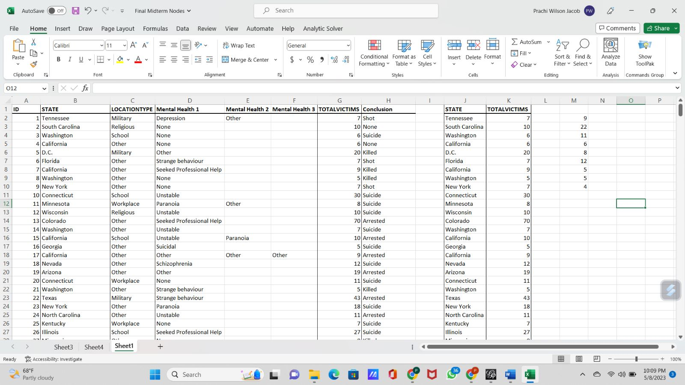
Dataset
Initial Dataset: 25 columns, filtered data manually
Selected State, Location Type, Total Victim
Extracted Information:
1) Mental Illness - Mental Health Notes
2) Conclusion - Summary
Link: https://data.world/awram/us-mass-shootings/workspace/file?filename=USMassShootings.xlsx

Slide 4
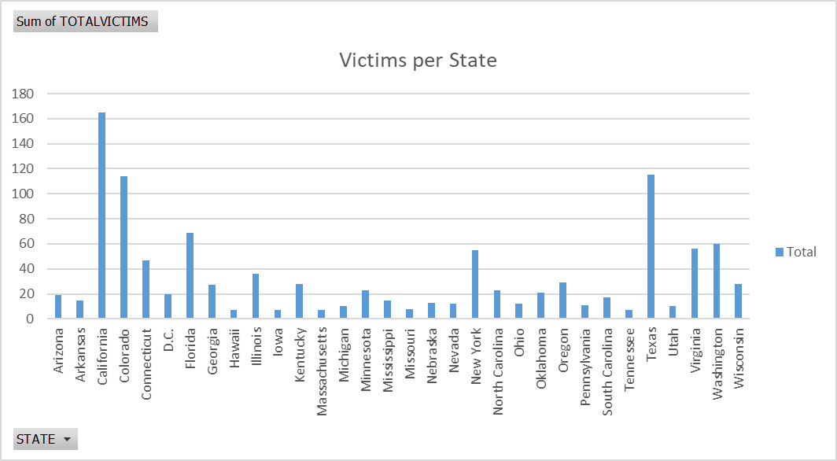
Descriptive Statistics
State: Name of the State
Total Victims: Total number of people wounded and dead

Slide 5
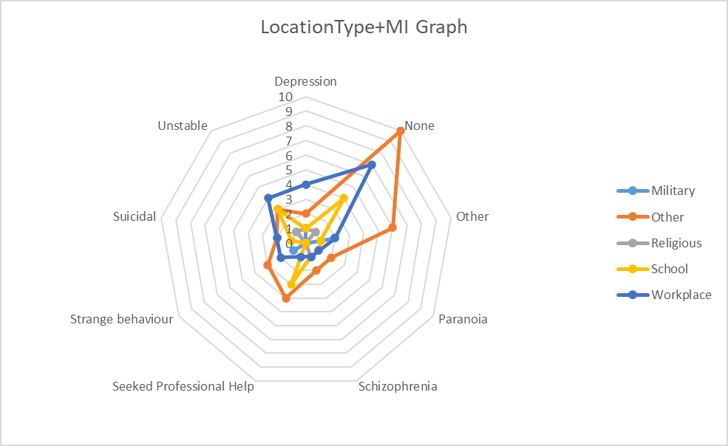
Descriptive Statistics
Location Type: Military, School, Workplace, Religious, Other
Mental Illness: Depression, Paranoia, Unstable, etc.

Slide 6
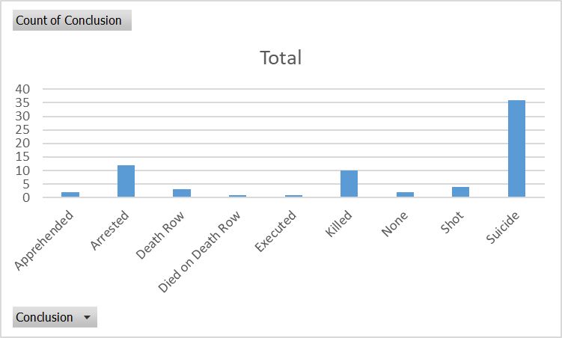
Descriptive Statistics
Conclusion: Describes what eventually happens to the shooter

Slide 7
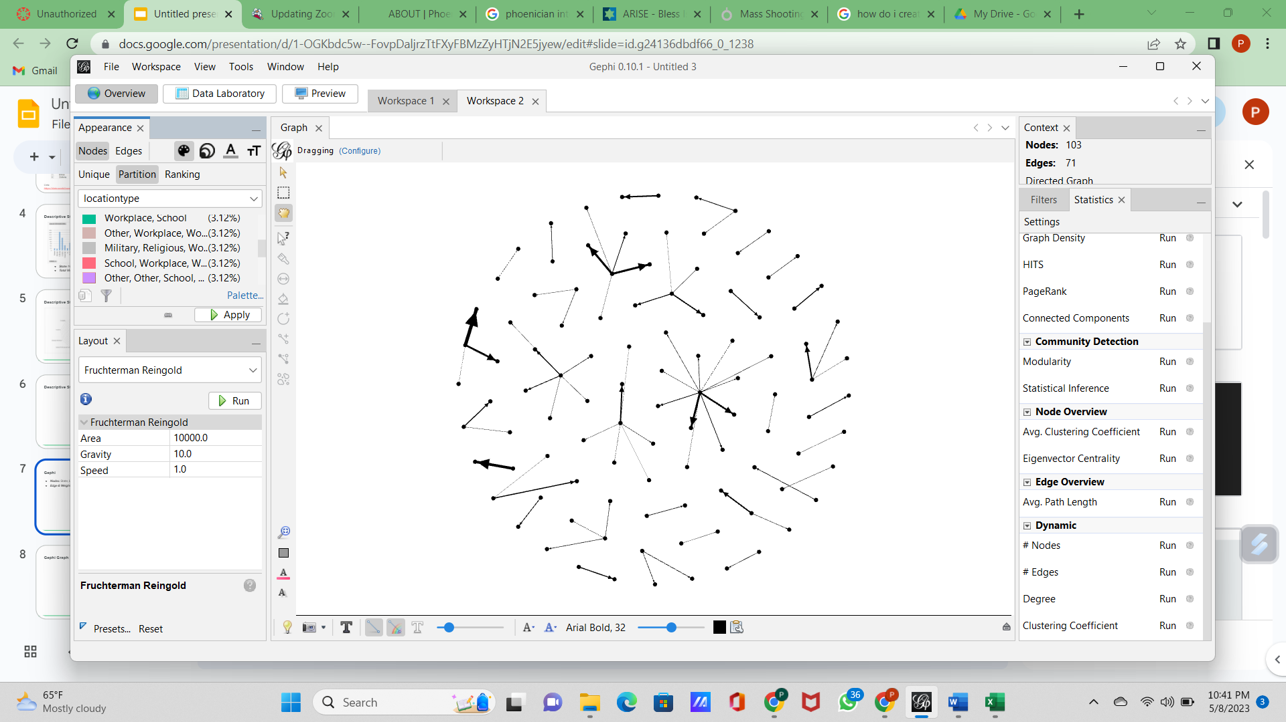
Gephi
Nodes: State, Location Type
Edge & Weight: Total Victims
Fruchterman Reingold

Slide 8
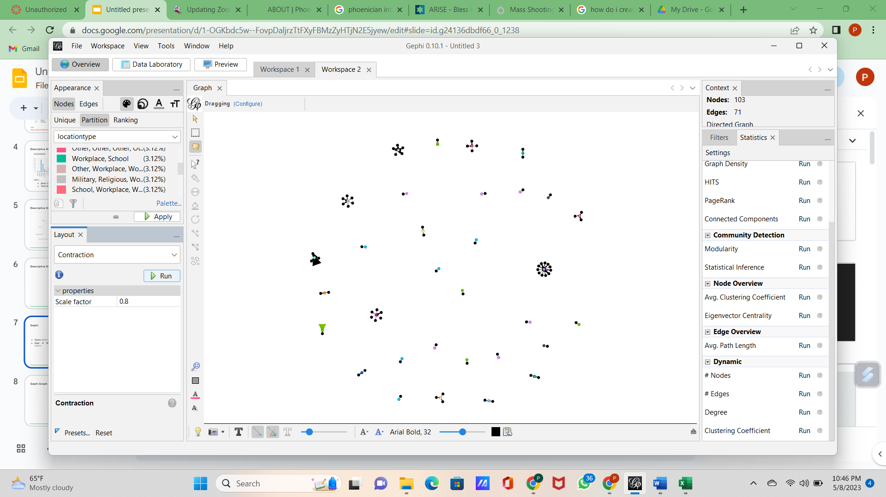
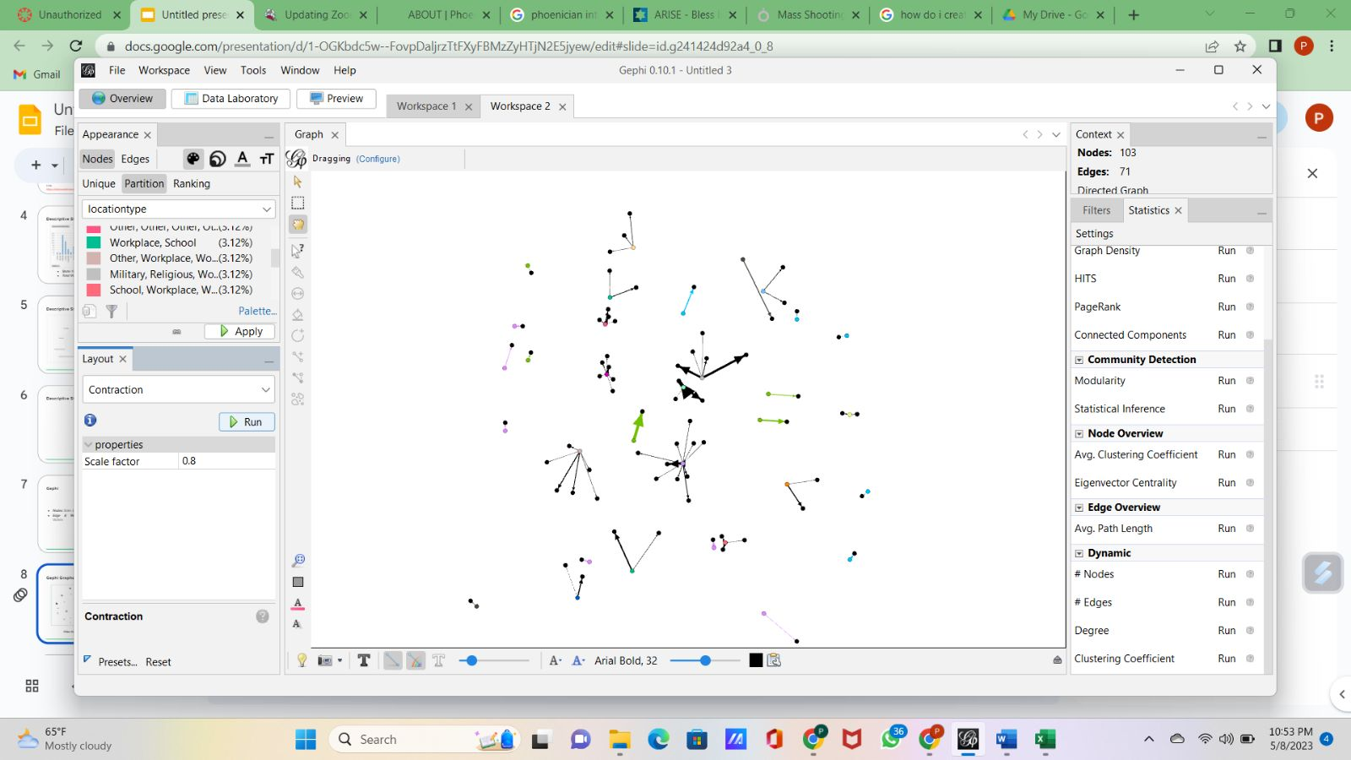
Gephi Graphs
Yifan Hu Proportional
OpenOrd and OverLap

Slide 9
Results
Most Shootings: California, Washington, Florida, Texas, New York
Maximum Victims: California, Texas, Colorado
Mental Illness: None, Unstable, Other, Depression, Seeked help
Most Location Types: None
Shooters mostly commit suicide

Slide 10
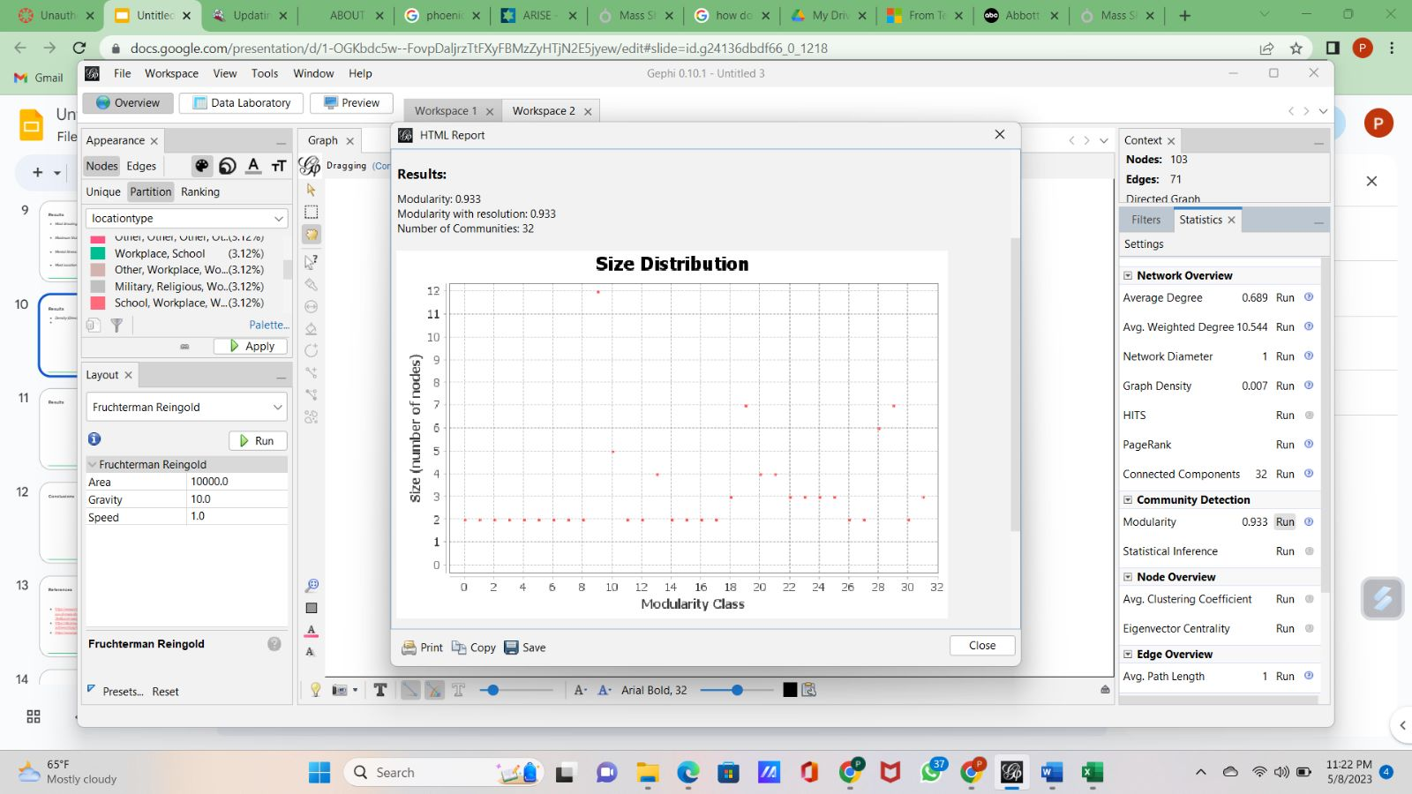
Results
Density (Directed): 0.007
Average Degree: 0.689

Slide 11
Conclusions
Based on number of cases and victims, California is the least safest
Lack of Mental Illness information or diagnosis
Most of the shooters commit suicide
If caught, they are either killed or arrested

Slide 12
References
https://www.msn.com/en-us/news/us/from-texas-to-california-us-sees-acceleration-of-mass-shootings/ar-AA1aUtzP?cvid=5eec435ec79a4398938ee2a9c8ac43b4&ocid=winp2fptaskbar&ei=7
https://abcnews.go.com/US/abbott-blames-texas-mall-shooting-mental-health-address/story?id=99166228
https://www.gunviolencearchive.org/reports/mass-shooting

Slide 13
THANK YOU

